Slide 1


Cybersecurity capstone
Ethan Hoyt

Slide 2
DHCP Starvation attack
The attacker will send a bunch of bogus DHCP requests with a spoofed MAC address.
The DHCP server then tries to respond to these messages and as a result the pool of IP addresses used by the DHCP server are eliminated.
This type of attack can result in a denial-of-service attack (DoS) or man in the middle attack (MITM).

Slide 3
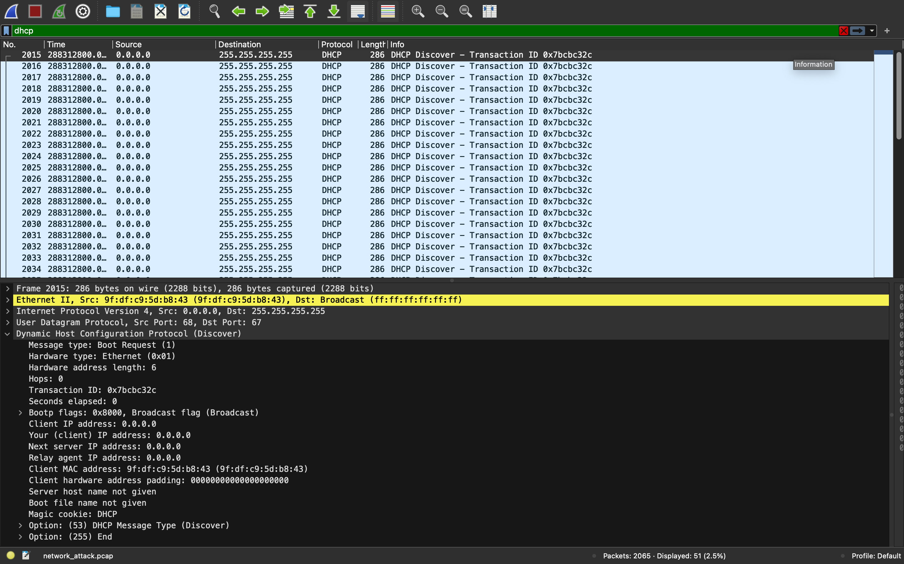

Slide 4
Analysis & Mitigation/Prevention
After analyzing all the packets in this capture, I came across a ton of DHCP requests coming from the same source that were going to the same destination.
Port security is a way to mitigate the effects of this type of attack.
The key to preventing such attacks and maintaining network security is finding ways to prevent attackers from flooding DHCP servers with forged DISCOVER packets, preventing them from offering IP addresses to legitimate clients.

Slide 5
